Slide 1
How to Install and Use Bootstrap
Install Bootstrap in ASP.NET Core Using Library Manager
You need to follow the below steps to install Bootstrap using the Library Manager (Libman).
Right-click on the “Project Name” in the Solution Explorer and then select “Add > Client-Side Library” which will open “Add Client-Side Library” window.
Leave the default provider as it is which “cdnjs” is in this case. The other providers are filesystem and unpkg.
In the “Library” text box, just type “twitter-bootstrap“. You can also get intelligence support once you start typing. Once you select the matching entry, then it tries to install the latest version of bootstrap. However, if you want then you can also type the version manually you want. Here, we are installing the latest version of Bootstrap i.e. (“twitter-bootstrap@4.3.1”).
There are two radio buttons to select whether you to include “All library files” or “Choose Specific files“. If you select “All library files” radio button then all the files are going to be downloaded. On the other hand, if you select “Choose Specific files” radio button then you need to check the selected checkboxes as per your requirement. Here I am selecting the “All library files” radio button.
In the “Target Location” text box specify the folder location where you want the library files to be installed. By default, the static files are only served from the wwwroot folder. Here, I am going with the default location i.e. “wwwroot/lib/twitter-bootstrap/”.
Finally, click on the “Install” button as shown in the image below.

Slide 2
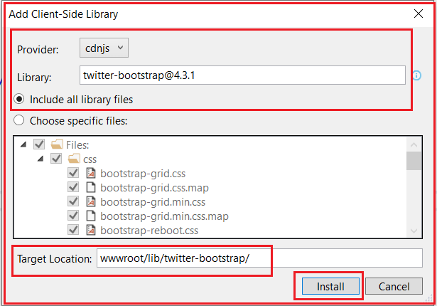
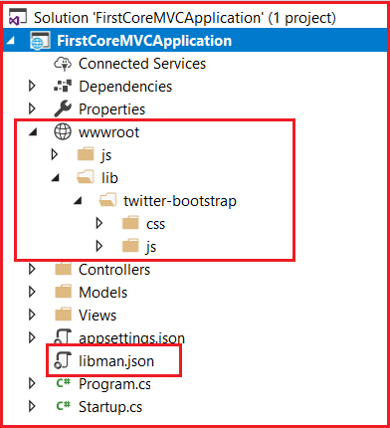
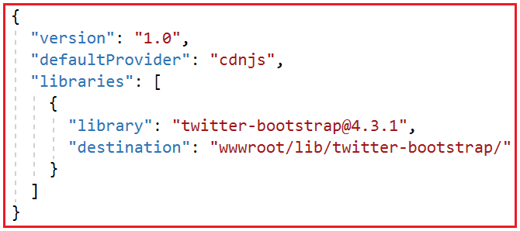
How to Install and Use Bootstrap
Once it successfully installed, then you will find two things. One is libman.json file and the second one the required bootstrap files. Please have a look at the following image.

Slide 3
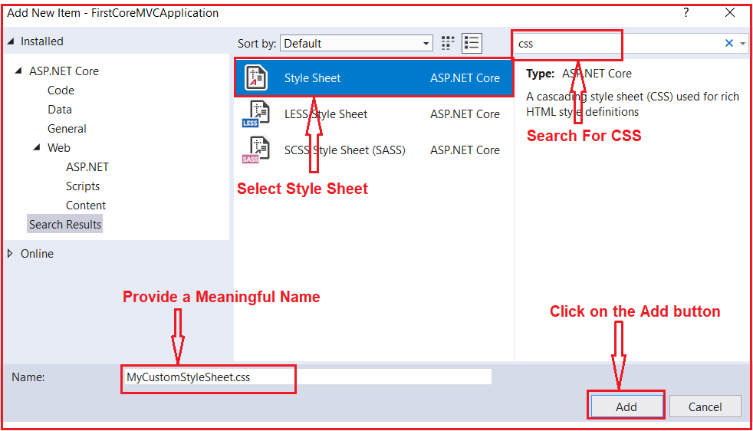
Creating a Custom Style Sheet
First, create a folder with the name CSS within the wwwroot folder.
All the custom CSS files are going to be created within this folder.
Once you create the CSS folder, let’s add a CSS file with the name MyCustomStyleSheet.css.
To create a style sheet, right-click on the CSS folder and then select “Add – New Item” from the context menu.
Then search for css and select Style Sheet, provide a meaningful name and finally click on the Add button as shown in the below image
Note: All the site custom CSS need to be placed within the MyCustomStyleSheet.css file.
So, open the MyCustomStyleSheet.css file and copy and paste the following code in it.
.btn {
width: 80px;
}

Slide 4
Using Bootstrap in ASP.NET Core MVC
To use bootstrap, first, you need to include a reference to the bootstrap.css file. You can add the reference in each individual views.
But if we are going to use the Layout file, so add a reference to the bootstrap.css file in the _Layout.css file. Along with bootstrap.css, we are also including a reference to our custom style sheet i.e. MyCustomStyleSheet.css.
<!DOCTYPE html>
<html>
<head>
<meta name="viewport" content="width=device-width" />
<title>@ViewBag.Title</title>
<link href="~/lib/twitter-bootstrap/css/bootstrap.css" rel="stylesheet" />
<link href="~/css/MyCustomStyleSheet.css" rel="stylesheet" />
</head>
<body>
<div class="container">
@RenderBody()
</div>
</body>
</html>
As you can see in the HTML code, we have included references for both bootstrap.css as well as MyCustomStyleSheet.css files. Here, we are also using the bootstrap container class for positioning the elements on the page

